Slide 1
F# for the W(in|eb)
Tomas Petricek @tomaspetricek
Conspirator behind http://fsharp.org

Slide 2
software stacks trainings teaching F# user groups snippets mac and linux cross-platform books and tutorials
F# Software Foundation
F# community open-source MonoDevelop
http://www.fsharp.org
contributions research support consultancy mailing list

Slide 3

The Data

Slide 4

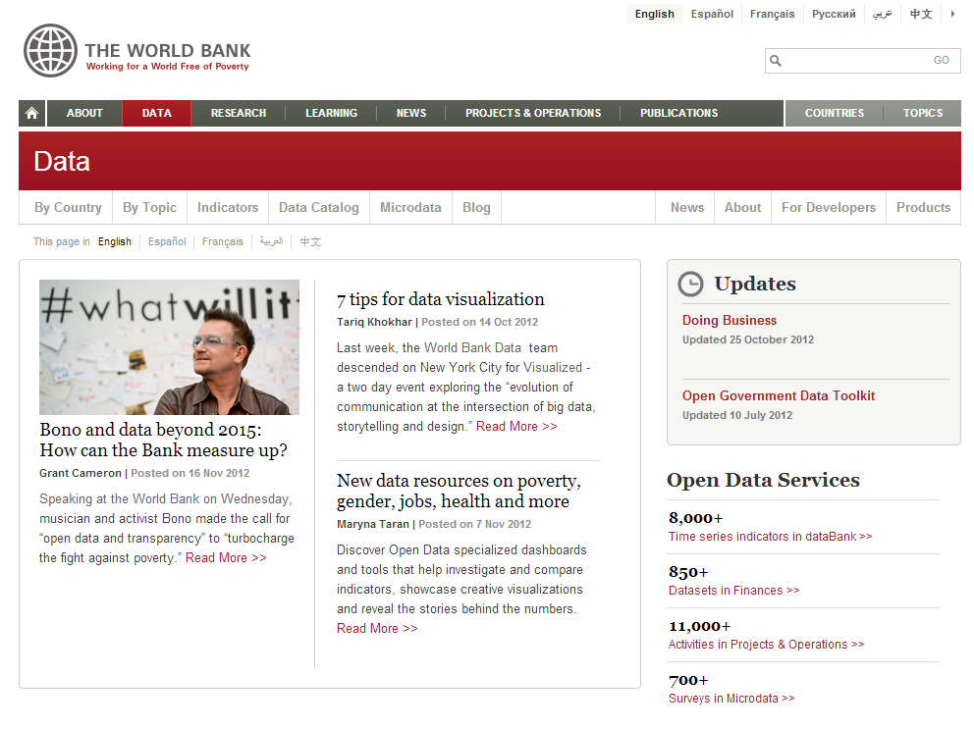
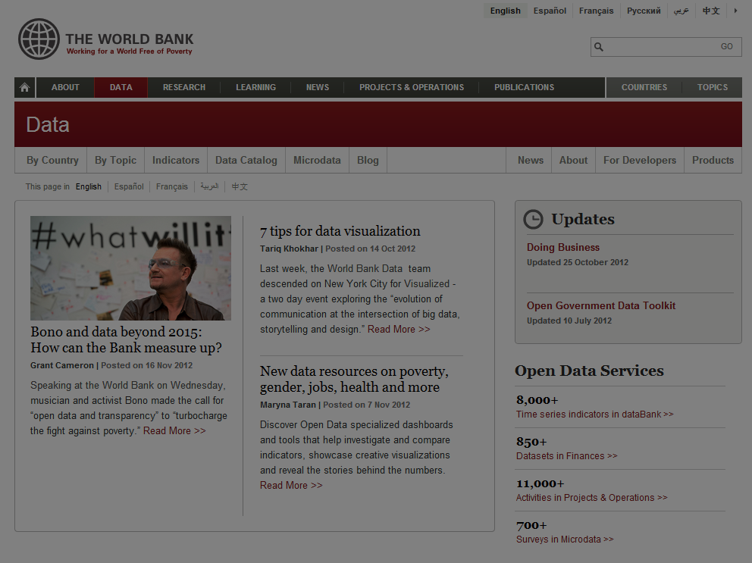

Slide 5
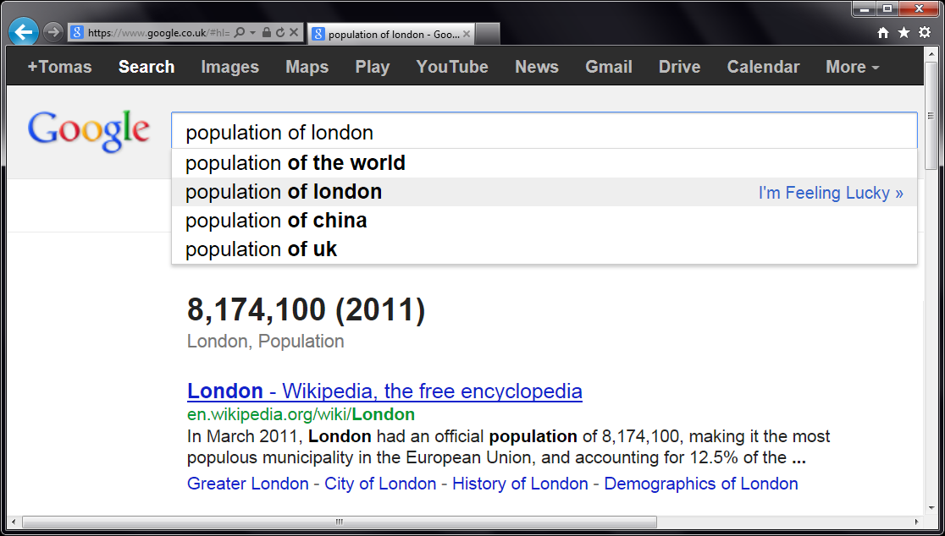
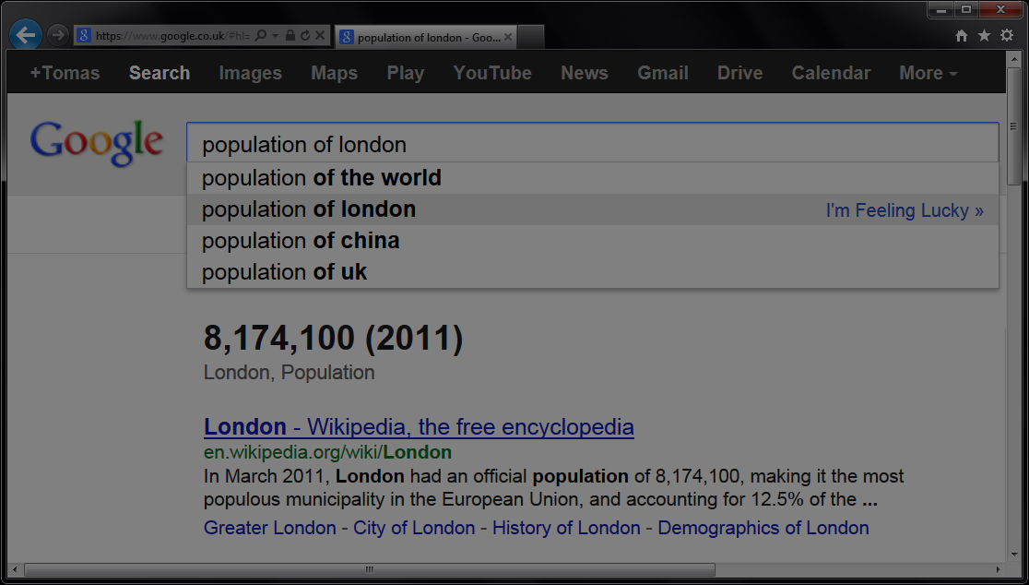


Slide 6
let wb = WorldBank()
w
b
.

Slide 7
[DEMO]
Exploring WorldBank Data

Slide 8
Asynchronous programming
Asynchrony matters
Node.js and C# 5.0
F# Async workflows
Without inversion of control
Exception handling and loops simple
Sequential and parallel composition

Slide 9

The Web

Slide 10


Slide 11
F# for the Web
Content Site
Application
Static content
Storage is cheap
Mobile and Web
Dynamic content
JavaScript & HTML5
Google friendly

Slide 12
F# for the Web
Content Site
Application
REST API
Type Providers
F# Formatting
http://tomasp.net
F# to JavaScript
Ask later :-)

Slide 13
F# for the Web
Server-side standard .NET libraries
ASP.NET Web API
ServiceStack, NancyFX
Why F#? on the server-side
Asynchronous workflows & agents
Type providers for data access

Slide 14
[DEMO]
WorldData using ASP.NET WebAPI

Slide 15
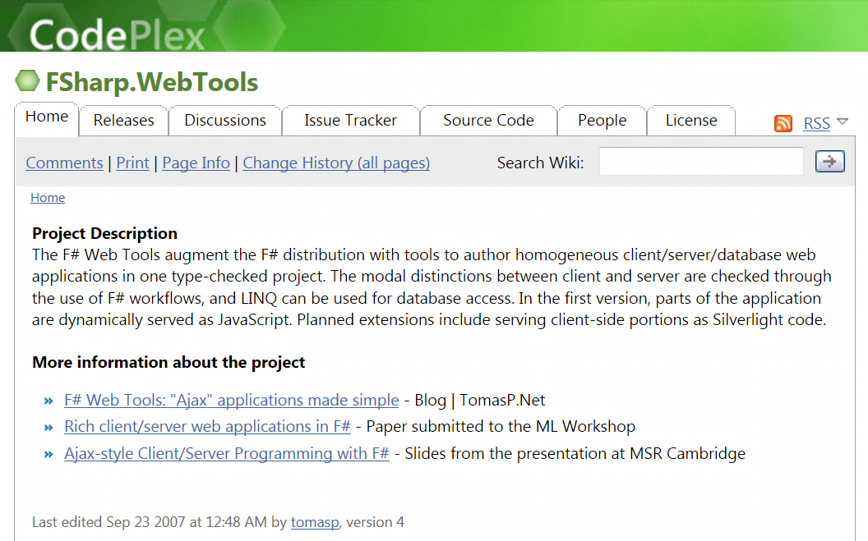
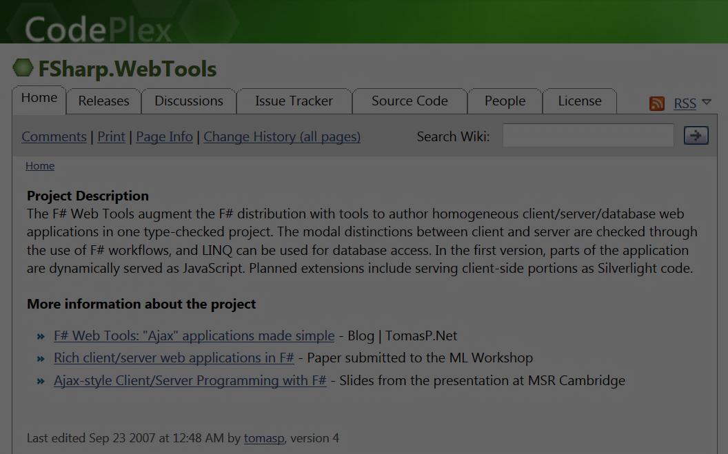

F# to JavaScript (2007)
“Before it was cool.”

Slide 16
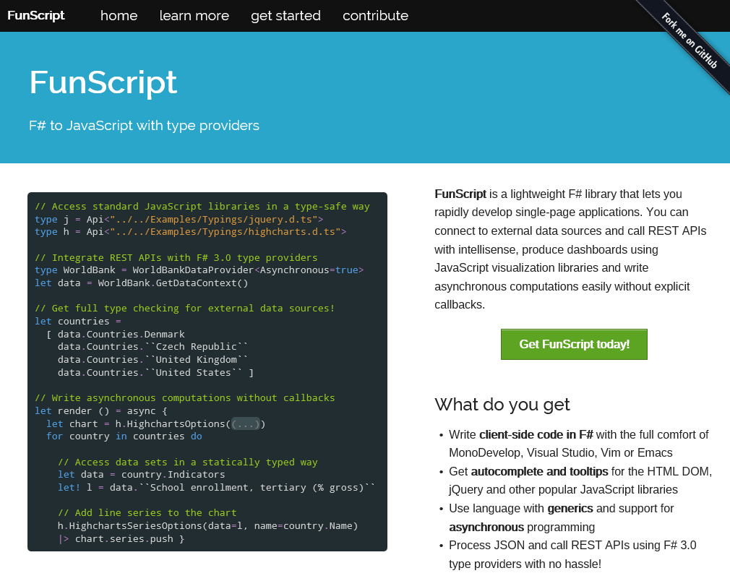
F# to JavaScript (2013)

Slide 17
[DEMO]
WorldBank App for the Web
http://funscript.info/samples/worldbank/

Slide 18
F# to JavaScript
TypeScript type provider
Import types for JS libraries
Somebody else writes them!
Libraries & frameworks
Open source: FunScript (lightweight, Apache 2)
Commercial: WebSharper (more than just JS)

Slide 19
Accessing REST services
REST (Representational State Transfer) is a style of software architecture for distributed systems such as the World Wide Web. REST has emerged as a predominant Web service design model.

Slide 20
[DEMO]
REST API and JSON provider

Slide 21
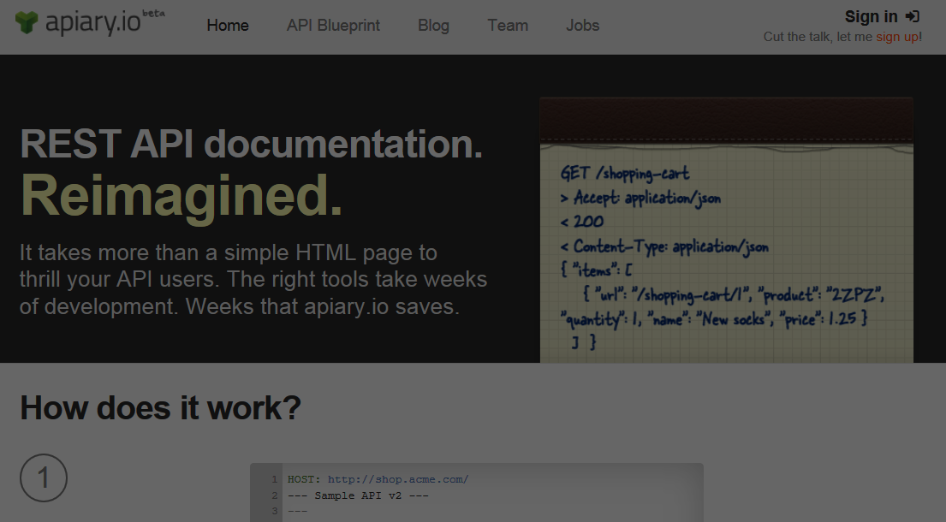
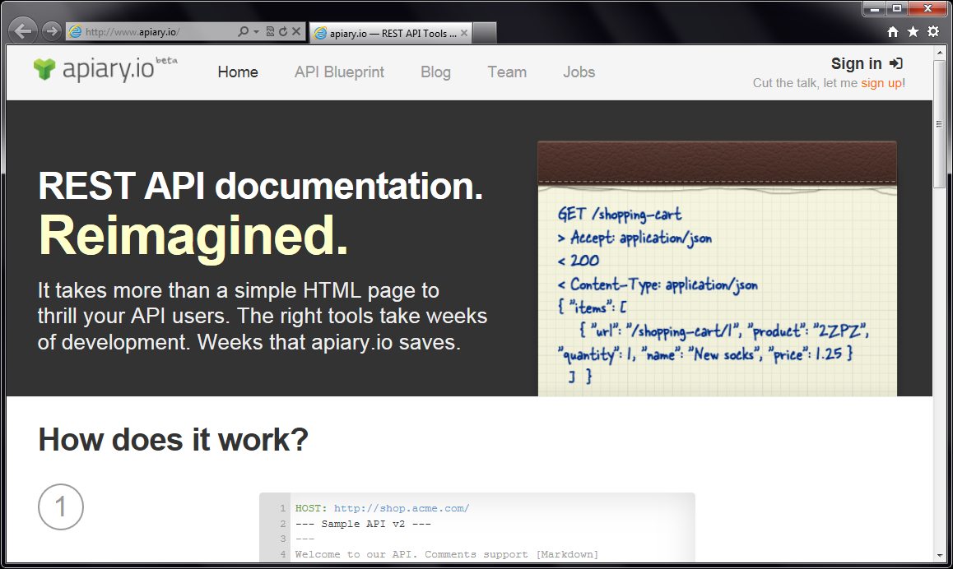
Accessing REST services

Slide 22
[DEMO]
Introducing Apiary Type Provider

Slide 23
Apiary.io Type Provider
Common REST conventions
GET /movie/{id} Get movie summary
GET /movie/{id}/casts Get cast details
Types from JSON samples
{ "page": 1, "total_pages": 1, "total_results": 5,
"results": [ { "title": "Skyfall", "id": 94221 } ] }

Slide 24
[DEMO]
The Movie Database Web App
http://funscript.info/samples/moviedatabase

Slide 25
Type Providers in Action
WorldBank Type Provider
JSON Type Provider
Apiary Type Provider
TypeScript Type Provider

Slide 26
[SUMMARY]
Where to learn more?

Slide 27

Trainings & Learning
Functional and F# trainings
London, New York or on-site
Get in touch tomas@tomasp.net
Upcoming F# Deep Dives book
http://manning.com/petricek2

Slide 28
F#, Data and Services
other languages web type script REST
R language transparent java script
tool support extensibility code-first unstructured data static typing inference schema
Love the Data
and integration

